Slide 1
Open Water Officials Clinic
Certification Training for:
Open Water Judge
Open Water Referee
Revision 04
Prepared by Jim Riggs, NC Swimming
jsriggs1@bellsouth.net

Slide 2
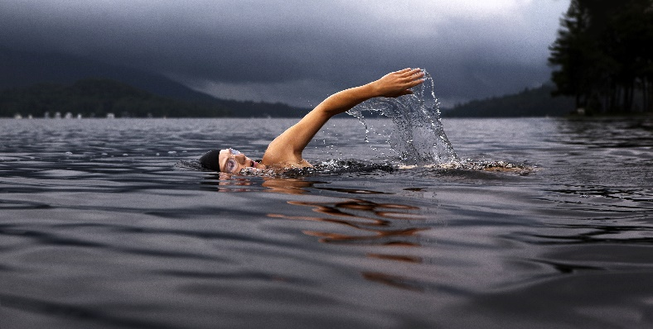
OPEN WATER
…but first
…a swimmer’s perspective

Slide 3
Objectives
Provide a safe and competitive venue for open water swimming
Promote an approach and organization at USA Swimming Open Water meets consistent with other LSCs and National events
Training for officials specific to open water swimming
Provide an officials certification process

Slide 4
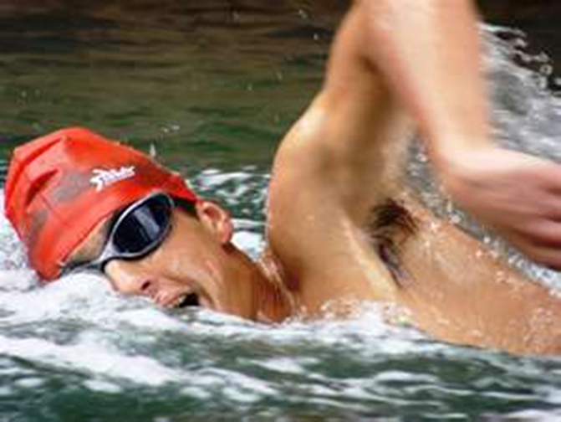
Clinic Contents
OW Introduction
Certification process
Safety
Roles and duties
Venue standards
Swimmer Markings
Rules
Rule Examples
Next Steps

Slide 5
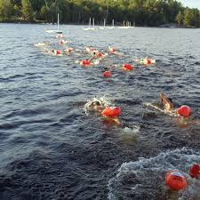
OW Introduction
Wetsuits optional at 20C (68F) and mandatory at 18C (64.4F).
Team Events with various formats.
Freestyle events.
Meet info includes course abandonment and races escorted or unescorted.
Starts: [1] in-water; [2] from beach with run into water; [3] from fixed platform.
Each swimmer numbered on the body.
Timing until event limit is reached.
Officials positioned along course on land and watercraft.

Slide 6
Certification Process - OW Judge
Current NCS Certified Official and/or USAS membership, Background Check, Athlete Protection Training, and Concussion Protocol Training.
Complete USAS OW Judge Test with 80% or better.
Apprentice:
Current NCS: ST, SR, or DR must be observed in one OW meet.
Not currently certified NCS must be observed in two OW meets.
OW MR to notify Officials Chair of status.
Certification valid for three years.

Slide 7
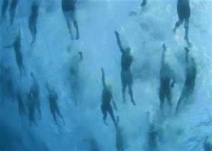
USA Swimming Certification Testing
Two certification tests:
Open Water Judge
(OTS Code: OWJ)
Open Water Referee
(OTS Code: OWR)

Slide 8
Safety
Safety is the paramount concern
Sanction must be approved by the Zone and then the LSC for all events.
Host Committee develops the safety plan per the sanction application.
The authority to stop a race for safety concerns can be made at any time either by the :
Referee
Meet Director
Independent Safety Monitor

Slide 9
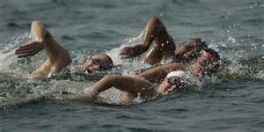
Event Rules
The Host Committee includes in the meet announcement:
Policy for abandonment.
Escorted or Unescorted swims:
Escorted: each swimmer with observance
Unescorted: swimmers observed by zones

Slide 10
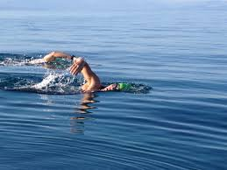
Open Water Sanction
Required sanction format available at USAS website
Format requirements include:
Key personnel
Emergency Response Plan
Course Abandonment Plan
Independent Safety Monitor
Water quality
Map of the course

Slide 11
Roles and Duties (1)
Meet Director
Primary contact for general meet activities.
Determines the course.
Authority to withdraw the sanction due to safety concerns.
Stop a race at any time for safety concerns.

Slide 12
Roles and Duties (2)
ISM (Independent Safety Monitor)
Approved by the LSC Sanction Chair.
Independent of event management: may supersede. activities in the interest of safety.
Assures the safety plan is implemented and deployed.
Withdraw sanction or stop a race for any time for safety concerns.
Attends and supervises all elements of safety including:
Support resources (people, vehicles and equipment).
Environment for swimmers and attendees.
Has contact with all areas of the event via dedicated radio.

Slide 13
Roles and Duties (3)
Officials:
Referee*
Assistance Referee
Admin Referee
Announcer
Medical Officer
Clerk of Course
Chief Timer* with 3 Timers
Recorder
Safety Officer*
Starter
Chief Finish Judge*
Race Judge (one per swimmer in escorted races)
Turn Judge (one at each change in direction)
*Dedicated role.
Not combined with the duties with any other official.

Slide 14
Roles and Duties (4)
Referee
Pre-race briefing for all participants, coaches, and event personnel
Course, markings, signals.
Safety procedures.
Authority to withdraw the sanction due to safety concerns.
Stop a race at any time for safety concerns.
Use of video and other devices to verify order of finish.
Signal start status.
Authority to start in waves and/or separate by age group or abilities.
Assistance Referee
Perform all duties assigned by the Referee.
Admin Referee
Responsible for administrative duties.

Slide 15
Roles and Duties (5)
Safety Officer
Responsible to the Referee for all aspects of safety.
Escort craft suitability and back up.
Verify safety of start and finish.
Provide information to participants on tides and currents conditions.
Liaison to the Medical Officer and updates Referee on any safety issues including course revisions.
Medical Officer
Responsible to the Referee for all medical aspects.
Informs local medical support of the event and evacuation process.
Advise the Referee, with the Safety Officer of unsafe conditions.

Slide 16
Roles and Duties (6)
Course Officer
Responsible for the course survey.
Verify course layout is ready for use.
Insure Turn Judges are in position.
Serve as pilot in the lead boat, when used.
Clerk of Course
Assembles and instructs competitors prior to the start and at the finish.
Verifies that competitors are properly marked and fingernails and toenails are trimmed, and no jewelry is worn, including no watches.
Inform competitors and officials of time intervals between event sessions including one minutes intervals during the last five minutes to start.

Slide 17
Roles and Duties (7)
Starter
Assume position clearly visible to all competitors.
On signal from the Referee, raise a distinctive flag to a vertical position.
To start, bring the flag down while activating and audible signal.
When starting from a fixed platform, verify swimmers have at least one foot forward, and stationary for the command of “take your mark”.
Race Judge
Positioned in boat to observe assigned swimmer at all times with violations recorded and reported to the Referee.
Authority to remove a swimmer when the event expires.
Maintain clearance between swimmers.
Alert the Referee of any withdrawals.
Immediately report rules infractions to the Referee.

Slide 18
Roles and Duties (7)
Turn Judge
Positioned to verify swimmer compliance at turns.
Record and report infractions to the Referee.
Chief Timer
Brief and assign Timers to positions.
Maintain and synchronize to the official clock.
Chief Finish Judge
Brief and assign Finish Judges to positions.
Determine order of finish and forward to Referee.
Finish Judge
Records order of finish of swimmers.
Recorder
Completes finish information including order of finish, withdrawals, and individual and team results.

Slide 19
Venue Standards
Markers
All Markers will be communicated in meet information and pre-race instructions.
Turn buoys are of distinctive color and will be turned by the swimmer.
Recommend one color for right turns, another color for left turns.
Guide buoys are supplemental, non-directional and different color from turn buoys.
Assist the participant to remain on course.
Additional buoys used for:
Finish line management to outline the chute.
Hazards (stay clear).
Out of Bounds (warm down area).

Slide 20
Venue Standards (2)
Fresh water or salt water.
Except at start and finish, minimum depth of 1.4 m (4.6 ft).
Water/Air Temperature:
Water temperature not less than 16C (60.8F).
Races of 5k and more, water temperature no greater than 29.5C (85F).
Air and Water temperatures added together not less than 30C (118F) and not greater than 63C (177F) .
Water Quality:
Meets standards of the local testing authority.
If heavy rains or flooding have affected the water quality, the Referee may postpone the meet

Slide 21
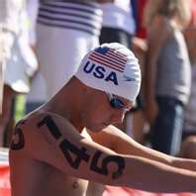
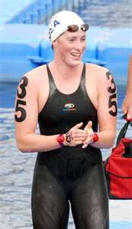
Swimmer Markings
Swimmer Marking
Vertically on each arm.
Horizontally on each back shoulder.
On each wrist (to support video at touch finish).
Referee may specify revised or additional markings.
Markings are used to identify the participants
During the swim.
For infractions, safety, coach contacts.
At the finish.
Order of finish.

Slide 22
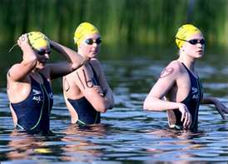
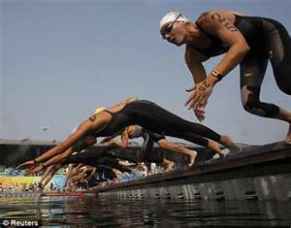
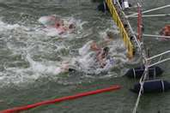
Start/Finish
Starts
In water or platform.
In water may require waves.
Platform with depth requirements per USAS 1.3.2.3.
No running starts.
Finish
Defined finish area with “chute” approach in water or exiting.
When timing chips are used the Timers recorded time will be the official time.
Actual finish placement will be determined by the manual finish judging and/or video replay if needed.

Slide 23
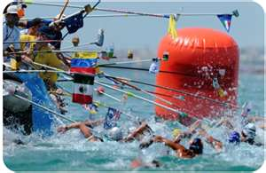
Feeding Stations
Required for events greater than 5K:
One station for events greater than 5K and less than 10K.
For events 10K or longer, at least on station every 2K.
Stations may be floating (anchored) or stationary.
Stations located on the inner or outer boundary of the course in line with the tour buoy.
Team support on the station assigned by lots.

Slide 24
Rules Summary (1)
Open water is a free style event.
Red Flag Disqualifications – Removal from Competition:
Two yellow flags (the second is a red flag).
Failing to finish the course.
Receiving assistance (pulling on cables, markers).
Receiving propulsion aid.
Walking or pushing off the bottom.
Receiving support from fixed or floating objects (intentionally contacting a vessel).
Unsporting conduct including intentionally striking another swimmer, refusing to correct a turn, intentional interference at the finish.
Swimwear violation including illegal suit or flotation (more than two caps.

Slide 25
Rules Summary (2)
Yellow Flag Caution:
Gaining an unfair advantage at the start (may escalate to red flag).
Receiving pacing.
Slipstreaming escort craft; refusal to swim clear.
Swimmer’s escort intentionally interferes with another competitor.
Intentional contact or interference with another swimmer.
Swimmer Notification:
Referee or designate will display the appropriate flag and card with swimmer’s number.
Whistle notification may be used.
Swimmer does not have to acknowledge.

Slide 26
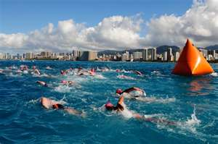
Rules Summary (3)
Swimmer Disqualification:
When a swimmer receives a red flag disqualification the swimmer must leave the water immediately.
Admin Referee is notified of swimmer’s status.

Slide 27
Ruling Example (1a)
Situation: In a 1 mile straight away race, the Referee observes swimmer #77 swimming butterfly with an alternating kick. What action should the Official take?

Slide 28
Ruling Example (1b)
Situation: In a 1 mile straight away race, the Referee observes swimmer #77 swimming butterfly with an alternating kick. What action should the Referee take?
Response: The Official should do nothing – Open Water Swimming events are freestyle events and the swimmer may swim in any manner desired.

Slide 29
Ruling Example (2a)
Situation: In a 5K race, the feet of swimmer #9 made intentional contact with goggles of swimmer #3 (who is swimming directly behind swimmer #9) causing the goggles to fill with water. The Official observed the contact. What actions should the Official take?

Slide 30
Ruling Example (2b
Situation: In a 5K race, the feet of swimmer #9 made intentional contact with goggles of swimmer #3 (who is swimming directly behind swimmer #9) causing the goggles to fill with water. The Judge observed the contact. What actions should the Judge take?
Response: Recommend to the Referee to immediately give a yellow flag caution to swimmer #9 for intentional contact which causes interference.

Slide 31
Ruling Example (3a)
Situation: A swimmer appears to be having difficulty. The safety craft approaches the swimmer. The swimmer states that he does not think he can finish the race and reaches up and grabs the edge of the craft. The swimmer’s coach shouts encouragement to continue. The swimmer lets go of the craft and resumes swimming. What action should the Official take?

Slide 32
Ruling Example (3b)
Situation: A swimmer appears to be having difficulty. The safety craft approaches the swimmer. The swimmer states that he does not think he can finish the race and reaches up and grabs the edge of the craft. The swimmer’s coach shouts encouragement to continue. The swimmer lets go of the craft and resumes swimming. What action should the Judge take?
Response: The Judge recommends the Referee gives a red flag disqualification to the swimmer for touching the craft.

Slide 33
